Slide 1


Introduction to Qualtrics

Slide 2
Outline
Free Access to Qualtrics through Cornell
Create a Project/Survey from scratch
Talk about Qualtrics Question Types
Preview and Publish surveys
Distribute your survey
Data & Results
Extras, Questions

Slide 3
Qualtrics through Cornell, Create Survey & Questions
Access Qualtrics for Free.
https://it.cornell.edu/qualtrics
Create Project
https://www.qualtrics.com/support/survey-platform/my-projects/creating-a-project/
Question Types
https://www.qualtrics.com/support/survey-platform/survey-module/editing-questions/question-types-guide/question-types-overview/

Slide 4
Distribution, Data, Results, Reports
Distributing Surveys, Contact Lists
https://www.qualtrics.com/support/survey-platform/distributions-module/distributions-overview/
Exporting Response Data
https://www.qualtrics.com/support/survey-platform/data-and-analysis-module/data/download-data/export-data-overview/
Results & Reports
https://www.qualtrics.com/support/survey-platform/reports-module/results-vs-reports/

Slide 5
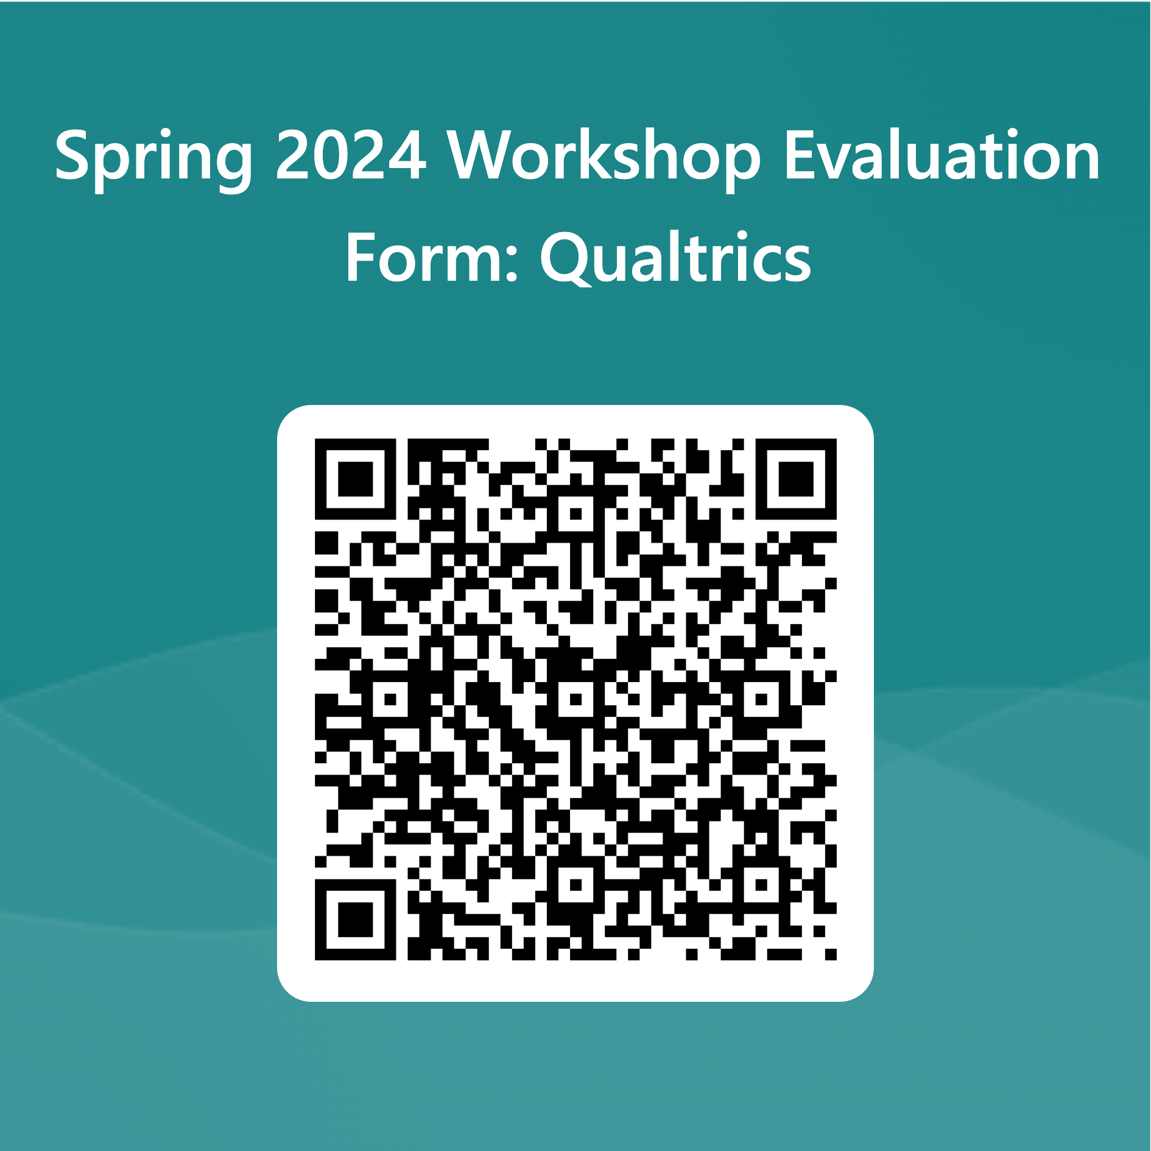
Evaluation
Link:
https://forms.office.com/Pages/ResponsePage.aspx?id=ZkN-XZsbz0WOebFLJ99G4SUXqdLlghJDhzZ5bd0gLPtUOVAyTFRHSFlSWjhFREhERlZQQTQ0U0FPRi4u

Slide 6
CCSS Resources
Cloud Computing Resources. Access to software for free
Schedule Consultation
Email questions to socialsciences@cornell.edu

Slide 7
Extras
Preview & Publish
https://www.qualtrics.com/support/survey-platform/survey-module/survey-publishing-versions/
Survey Flow
https://www.qualtrics.com/support/survey-platform/survey-module/survey-flow/survey-flow-overview/
Email Triggers. Post survey email once complete
https://www.qualtrics.com/support/survey-platform/survey-module/survey-tools/email-triggers/
Quotas. Limit total responses
https://www.qualtrics.com/support/survey-platform/survey-module/survey-tools/quotas/
General Tips
https://www.qualtrics.com/support/survey-platform/common-use-cases-rc/survey-tips-tricks/

Slide 8
Thank you!
Contact us at socialsciences@cornell.edu

